Slide 1

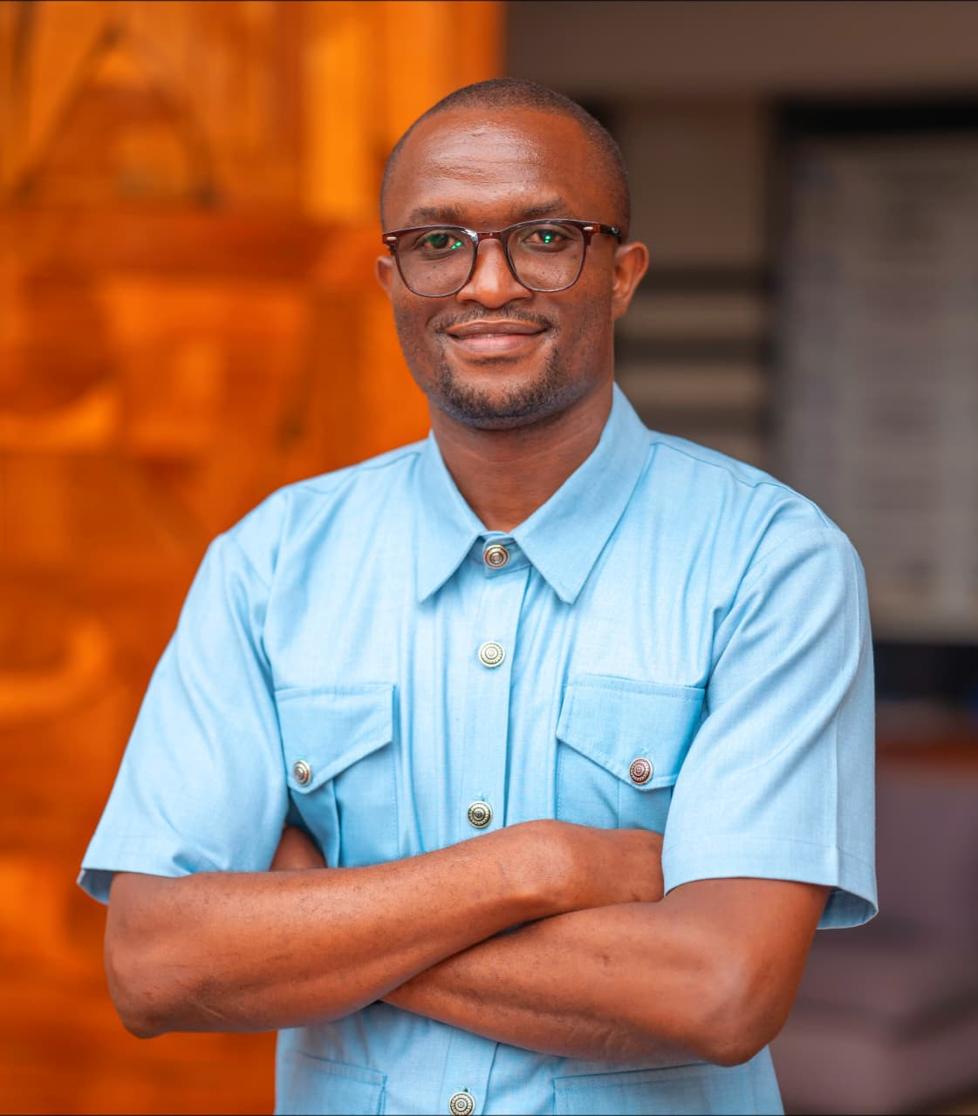

A Healthier Future Starts in the Classroom: Integrating IPC, AMR and One health in Schools.
Head Shot
David Frederick Akello
Pharmaceutical Technologist,
Antimicrobial Steward
Malindi Sub-County Hospital

Slide 2
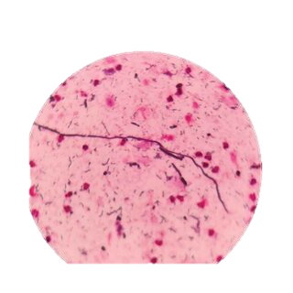
Introduction: The Silent Crisis
The Growing Threat of Antimicrobial Resistance (AMR)
AMR is the silent pandemic already raging in our hospitals, our farms, our environment
In 2019: AMR contributed to ~5 million deaths globally.
1.27 million deaths were directly attributable to drug-resistant infections.

Slide 3
Introduction: The Silent Crisis
The Growing Threat of Antimicrobial Resistance (AMR) cont…
By 2050, it could kill 10 million per year more than cancer today.
This is the greatest health threat of the 21st century. And it is fueled by ignorance.
This is not science fiction; it is our current reality.
Notes:
NOT FROM A VIRUS. NOT FROM WAR. FROM DRUG-RESISTANT INFECTIONS.

Slide 4
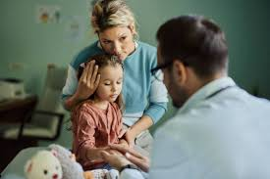
Meet Amina. This is Personal.
Imagine: A simple scrape. A common infection. The first antibiotic fails. The second. The last resort fails.
This is the world we are building for Amina, for all our children.
A world where a child’s life is threatened by a once-routine infection.
A world where modern medicine loses its miracle.
We are not just fighting bacteria. We are fighting time.

Slide 5
The Levers of the Crisis
WE ARE POURING GASOLINE ON THE FIRE
The common denominator? A profound lack of knowledge.
In Our Homes | On Our Farms | In Our systems
Demanding antibiotics for colds and flu | 70% + of antibiotics used for growth promotion & prevention in livestock. | Lack of clean water & sanitation.
Poor hand hygiene | Contaminating soil & water. | A devastating gap in EDUCATION.

Slide 6
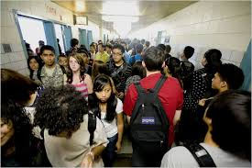
The Critical Blind Spot: Our Schools
We send our children to school to learn about the world.
But we fail to teach them how to save it.
They learn Pythagoras Theorem but not how a sneeze spreads disease.
They learn about ecosystems but not how drugs in livestock affect human health.
They graduate as brilliant minds completely unarmed against their greatest health threat.
We are missing the most powerful vaccine-delivery system we have: our education system.

Slide 7
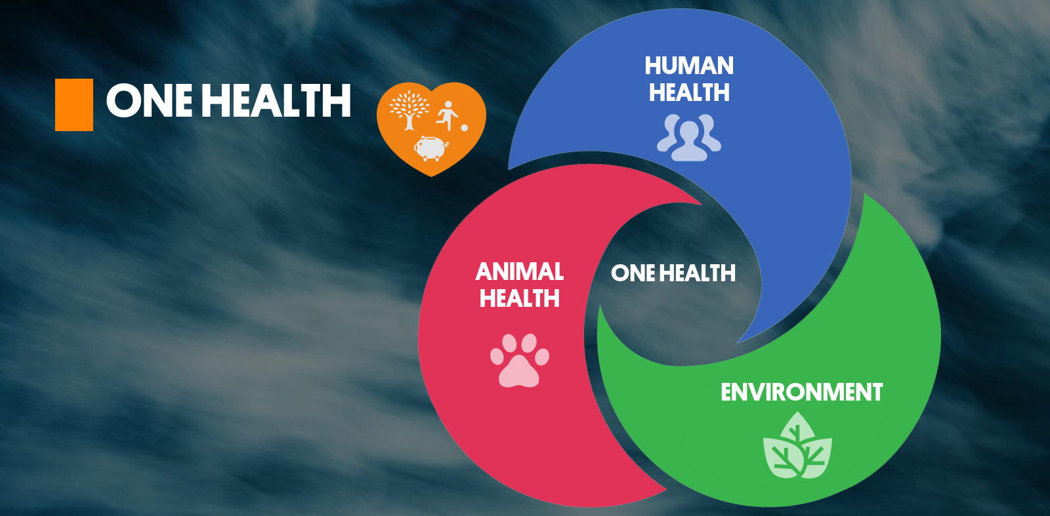
The Paradigm Shift: One Health
WE CANNOT SOLVE A CONNECTED PROBLEM WITH ISOLATED SOLUTIONS.
Human Health. Animal Health. Environmental Health.
They are one and the same.
The solution isn't just in a lab. It's on the farm. It's in the classroom. It's at the sink.
It is a fundamental shift in how we see
our world.

Slide 8
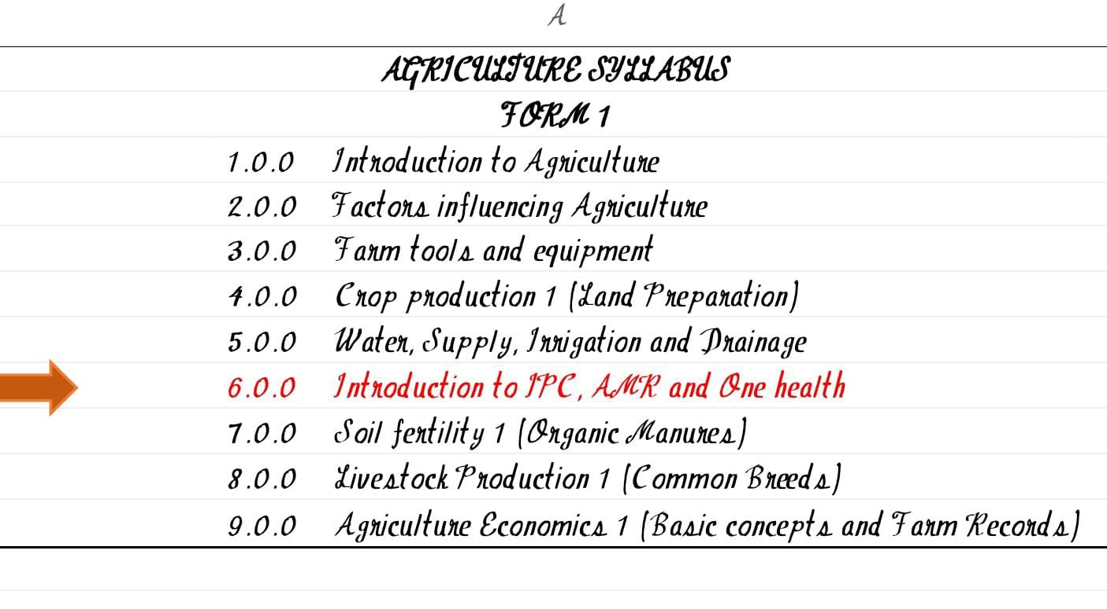
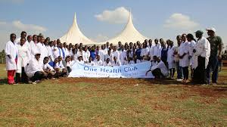
The Blueprint: Our School-Based Defense Strategy.
WE BUILD THE SHIELD IN FOUR LAYERS:
1. CURRICULUM INTEGRATION: Weaving IPC & AMR into Science, Biology, Agriculture from primary to university.
2. STUDENT AMBASSADORS: Creating "One Health Clubs" for peer-to-peer education and community outreach.

Slide 9
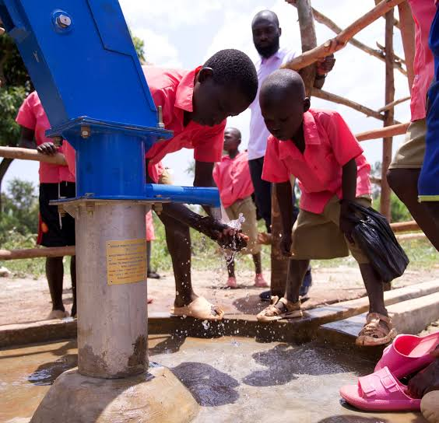

The Blueprint: Our School-Based Defense Strategy. …cont..
WE BUILD THE SHIELD IN FOUR LAYERS:
3. WASH AS A FOUNDATION: Making handwashing, clean water, and sanitation a non-negotiable part of the school day.
4. CROSS-SECTOR LINKAGES: Connecting students with local farms and health facilities for real-world learning.

Slide 10
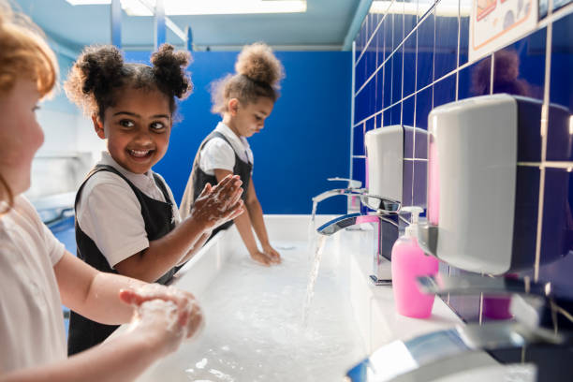
Proof of Concept: The Ripple Effect
EDUCATION IS A VIRUS MORE POWERFUL THAN ANY PATHOGEN IT SPREADS.
The Student learns proper handwashing → reduces infections at Home.
The Agriculture Student learns responsible drug use → protects the Food Supply.
The Community becomes informed → demands better practices from Leaders.
This is how we achieve herd immunity against
misinformation.
This is the ripple that becomes a wave.

Slide 11

The Return on Investment: A Future
Investing here is not an expense. It is the ultimate prevention which in turns;
  Saves Lives: Slows AMR, protects our antibiotic arsenal.
  Saves Money: Reduces healthcare costs, secures food production.
  Builds Resilience: Creates a generation of informed citizens who think critically about health.
  We can pay for education now, or we will
  pay infinitely more in lives and treasure later.

Slide 12
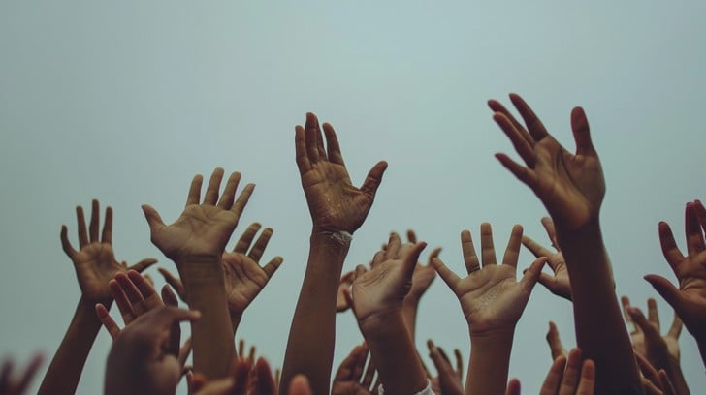
Our Call to Action: Be the Antibiotic for Ignorance
THIS IS NOT A REQUEST. IT IS AN URGENT APPEAL TO ACTION.
We call on policymakers to INTEGRATE this into national curricula.
We call on educators to CHAMPION this in their classrooms.
We call on global health leaders to FUND this critical work.
Let us not be the generation that stood by as the miracles of modern medicine faded.
Let us be the generation that educated its way out of crisis.
The next chapter of human health starts not in a lab, but in a classroom.
Let's write it together.

Slide 13
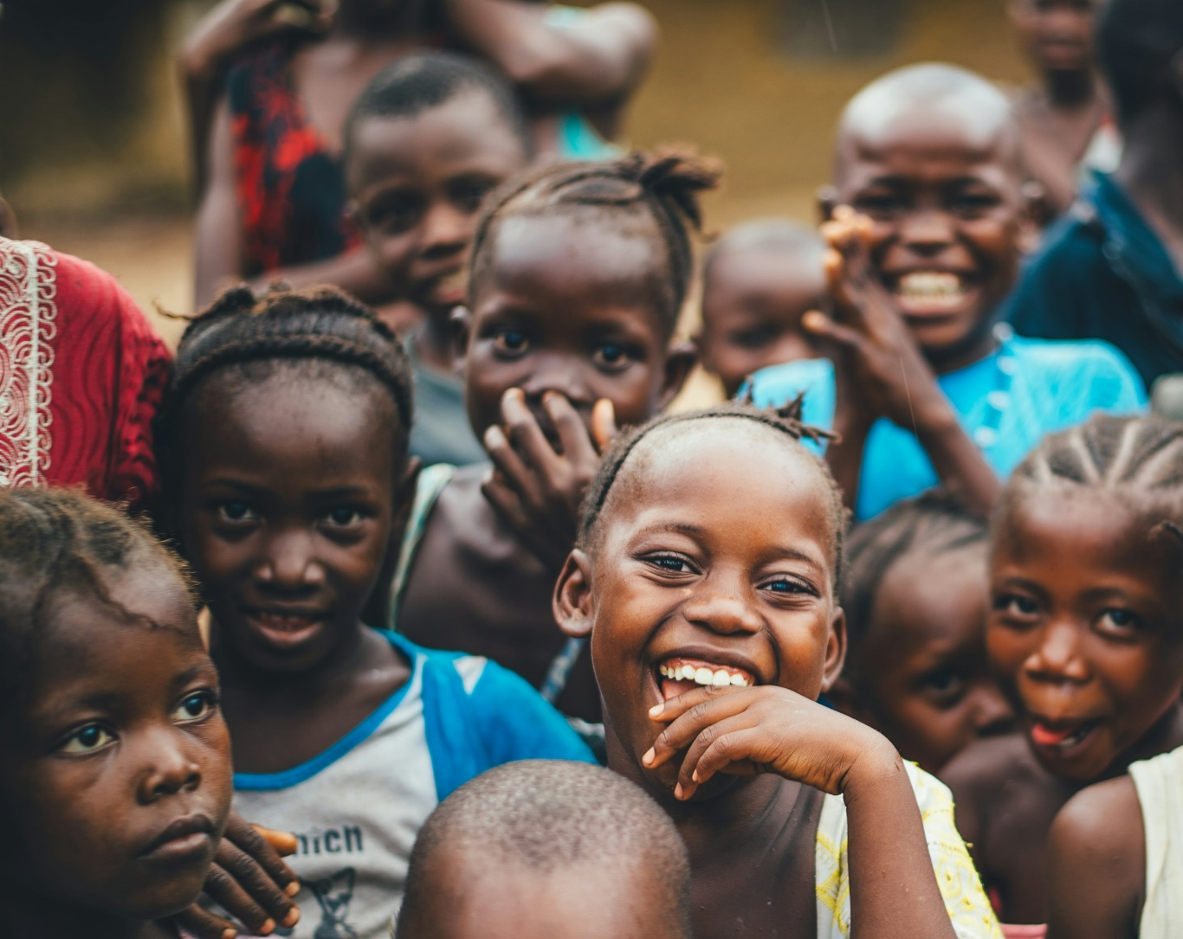
"The greatest medicine of all is teaching people how not to need it."- Hippocrates

Slide 14
THANK YOU
Acknowledgement:
Malindi SCH
IPNET KENYA

